Slide 1
Mastering System Design
Section 4: Architectural Patterns
System Design Fundamentals

Slide 2
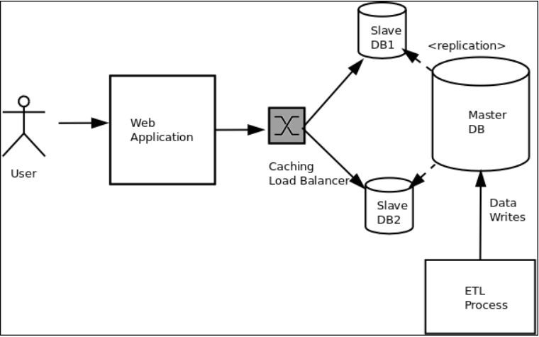
What is Software Architecture?
Deﬁnition: The structure of a system, including its components and relationships.
Why It Matters: Architecture impacts scalability, performance, and maintainability.
Importance in System Design & Key Design Considerations
  Scalability: Ability to handle increased data or
traﬃc.
  Maintainability: How easily the system can be updated or modiﬁed.
  Performance: Eﬃciency and responsiveness
under load.
"Keep in mind, the architectural choices you make directly inﬂuence system behavior."

Slide 3
Section Agenda
Introduction to Architectural Patterns
Software Architecture Patterns & Styles
Multi-Tier Architecture
Microservices Architecture
Event-Driven Architecture
Summary & Practical Applications

